Slide 1
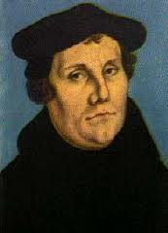
Chapter Twelve :Protestant Leaders and Movements
By: Maya Halthore
Period 5 Kinberg

Slide 2
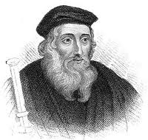
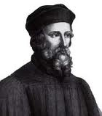
Early Ideas
The reformation did not simply begin when Martin Luther nailed his Ninety-five Theses onto the Wittenberg church door in 1517. There was a foundation for the beginnings of the reformation. The call for reform began early.
John Wycliffe (1330- 1384):
He was a theologian at Oxford University who spoke of authority primarily in scripture
He believed that anyone who could read should have access to a Bible.
He then translated the Latin bible into English. As this new translated Bible became more and more widespread, the Lollard movement was formed. These were people hungering for spirituality. This new need to understand the Bible by reading it angered the Church. All of the Lollards were persecuted. Yet the spread of knowledge was on .
Jan Hus
A Czech scholar at the University of Prague who had been attracted to the writings of Wycliffe
He demanded that the Bible be translated into Czech. He also brought forth the immorality of the clergy . The Council of Constance was called to deal with him, it was there that he was charged with heresy and eventually burned at the stake.
His death invoked a fight between the Czech people and the Holy Roman Emperor and the Catholic Church. The Czech people wanted the rights to condemn those from the clergy who were exploiting the land. In 1436, the Czech Republic achieved independence.

Slide 3
Additional Causes of the Reformation
Corruption of the Roman Catholic Church during the renaissance, sale of church offices, decline of morality
Impact of the Renaissance: humanism questioned Church traditions and contradicted the Church’s emphasis on salvation. People no longer saw the virtue of poverty
Declining prestige of the papacy through the Babylonian Captivity and the Great Schism
Resentments of secular rulers over the power of the popes and clergy. This enraged monarchs
Resistance to the power of Charles V. He took to much power as the Holy Roman Emperor
Invention of the printing press allowing dissenters to spread their ideas throughout Europe and make the Bible and available to everyone.

Slide 4
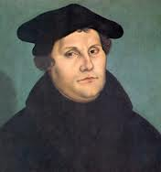
Martin Luther: The Beginnings
Martin Luther was the most important reformer of the Reformation
  Born on November 10, 1483 in Eisleben Saxony, now known as southeast Germany
  1484 he moved to Mansfield, which is very near his home town . As he grew older he went to the University of Erfurt to study law and eventually become a lawyer
  In 1505, Luther had a life changing experience that literally changed all of his ideals. He was caught in a terrible lightening storm where he feared for his life. Afraid that he would die he cried out, “Save me, St. Anne, and I’ll become a monk!” St. Anne was the patron saint of coal miners. The storm then subsided.
  Though his decision to disappointed his family, Luther kept his promise and switched his studies from law to theology. By 1512 he had a doctorate in theology at the University of Wittenberg.
  Although he was a popular teacher at his university, Luther was very troubled by how one obtains salvation, and essentially goes to heaven
  In 1510 Luther traveled to Rome and was thoroughly bothered by the immoral behavior of the clergy.
  After reading the Psalms in the bible, he began to believe that one achieves salvation from faith alone and not by good works like sacraments, praying, and fasting.

Slide 5
The Start of the Protestant Reformation
The original issue that really began the Reformation was the selling of indulgences, not just indulgences in general. Indulgences were used to raise money for the Church. In 1517 Albrecht of Mainz had borrowed money from the Fuggers, a very rich banking family in Augsburg, to pay for several churchly positions that he wanted. Not only this, but Pope Leo X wanted to build St. Peter’s Basilica in Rome. This caused him to ask Johann Tetzel, a Dominican Friar, to raise money. Tetzel began selling indulgences, chanting “As soon as gold in the basin rings, the souls in purgatory spring.” He was proclaiming that a person could pay their way out of hell. This slogan promoted a lot of business, but also horrified people like Luther, who condemned anyone who bought indulgences.
  On October 31, 1517, Martin Luther nailed his Ninety-Five Theses on the sale of indulgences onto the Church door at Wittenberg. This was a medieval way of starting debate.
  When Pope Leo X heard about this and all the new beliefs the theses proclaimed he thought nothing of it, saying that it was a “local problem” that would soon be resolved.

Slide 6

Beliefs of Lutheranism
From the years of 1517 to 1520 Luther wrote a set of works that outlined his most basic beliefs. These works include: The Babylonian Captivity (1520), The Freedom of a Christian Man (1520), The Ninety-five Theses (1517), On Christian Liberty (1520). (It would be a really good idea to check out all of these works!)
Basic Beliefs:
All work is sacred and each person should serve God in his or her own individual calling. The monastic or religious life is not better than the secular one.
Salvation is through faith alone. Influenced by the words of St. Paul in Romans 1:17, Luther rejected the Church’s position that a combination of good works and faith was necessary for salvation
Religious authority rests with the Bible, NOT THE POPE. The Bible was considered the final authority because each individual could interpret the texts for themselves.
Baptism ad Communion are the only true sacraments. The other five sacraments of the Catholic Church should be disregarded. Luther did not support transubstantiation in which bread and wine are changed into the body and blood of Christ. He instead believed the whole process was spiritual and not physical.
Marriage of the clergy should be allowed.
The Church consisted of every single Christian believer and not just the clergy.
Secular rulers are the supreme authority in all matters EXCEPT the theological ones. Political leaders began to support Luther because of this one, because it implied that the Pope would get less power

Slide 7
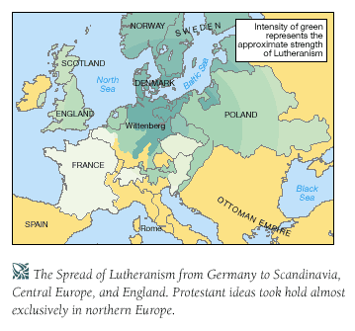
The Spread of Lutheranism
The pope excommunicated Luther in 1521. He then demanded that Luther appear before the church in the Diet of Worms, which was a meeting of German nobility and Holy Roman Emperor Charles V.
By now Luther was under the protection of Frederick the Wise of Saxony. Therefore when he was condemned a heretic, after saying “to go against conscience is neither right nor safe” to the clergy, he was protected.
At the Diet of Worms and the Diet of Speyer, Luther convinced many German Princes to follow his beliefs. The princes saw that if they joined Luther they could obtain many Catholic lands in their territories. They therefore declared a defiant protest to the Church, hence the name Protestant.
In the 1520s, Lutheranism spread throughout northern Germany, Denmark, Norway, and Sweden, where rulers seized Church properties and closed down monasteries. The German princes of the North protected Luther and his followers.
Many peasants in Germany followed Lutheranism because they were suffering economic hardship. The peasants looked to Luther for support, mistakenly believing that Luther’s idea of the priesthood of all believers was a call for social justice. THEY WERE WRONG. LUTHER ONLY WANTED THEOLOGICAL REFORM AND NOT SOCIAL REFORM.

Slide 8
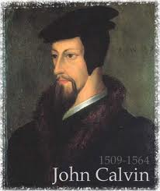
John Calvin (1509-1564)
An influential reformer in Switzerland
He was a trained lawyer who fled from France in fear that he would be persecuted for being a Protestant. He then went to Geneva, Switzerland.
He was very influenced by Luther’s works which came to France in 1518
Like Luther he believed that the Bible was the final authority in all matters and that one should interpret the Bible for themselves.
However, Calvin diverged from Luther’s beliefs in his views on the power of God and the nature of human beings regarding the role of the Church and state.

Slide 9
The Ideals of Calvinism
Calvin primarily agreed with everything Luther said except with the power of God and the role of the Church and the State. His ideals were outlined in his Institutes of Christian Religion (1536).
  Predestination: Calvin viewed man as sinful and corrupt and believed that God had already determined from the beginning who was going to be saved and achieve salvation (the Elect) and who was going to eternally damned. He argued that since God was almighty and all-powerful, and since he was our creator, by default he must have already determined whether one will achieve salvation or be eternally damned. There was no room for free will. Yet, Calvin also wrote that those who were predestined for salvation could be achieved by the good of their moral lives. In time Calvin also added that the Elect would be shown by economic success. He then implied that sign of damnination leading to the belief of Protestant Work Ethic and the importance of capitalism. For the first time, a religious doctrine permitted the charging of interest on loans.
  The Unity of Church and State: Calvin did not believe that the Church should not be ruled by the state. He wrote that the Church should be the moral force in the government. He then displayed this belief by making Geneva the first theocratic state and establishing the state religion of Calvinism. He closed off all the taverns and outlawed forms of amusement. Calvin was intolerant of anyone who would not follow his rules. He imposed laws that would control the religious and secular life of the people.

Slide 10
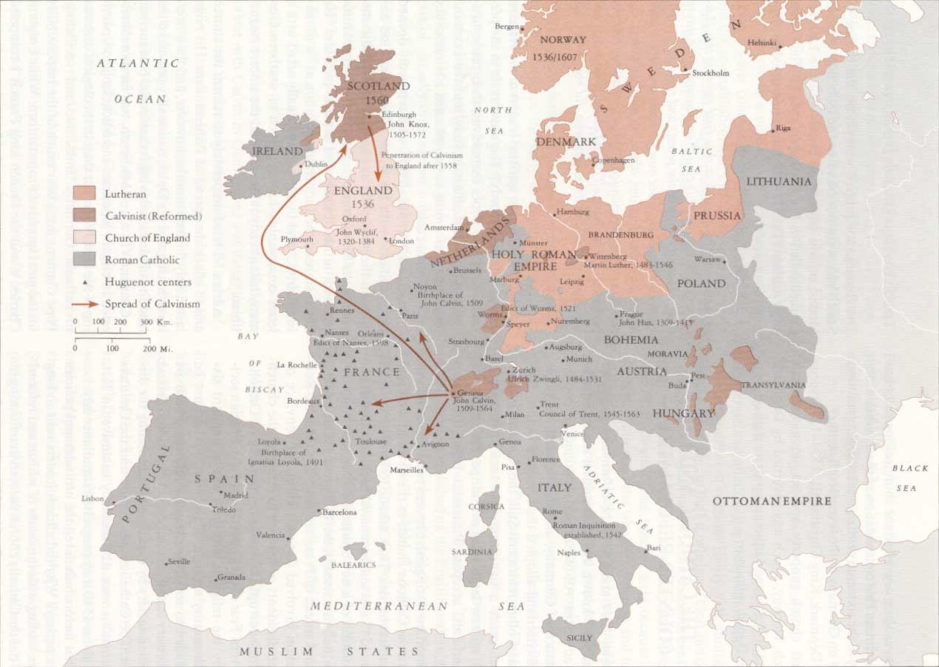
The Spread of Calvinism
During the 1540s and 1550s, Calvinism spread throughout Europe under many different names. People were attracted to the strong theological views of the Calvinists.
Presbyterianism was the name of Calvinism in Scotland. Protestant leader John Knox helped establish it as the state religion of Scotland
In France, Calvinists went under the name of Huguenots. They made significant gains in their country, but were brutally suppressed by the Catholics
The English Calvinists went under the name of Puritan. In the 1600s they attempted a revolution in their land, but failed. They then came to America under the name of pilgrims and brought Calvinism to America

Slide 11
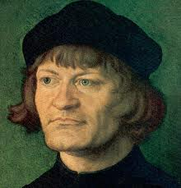
Ulrich Zwingli (1484-1531)
Much like Calvin, Zwingli was thoroughly influenced by the writings of Martin Luther. The important of the printing press and the newly translated Bible allowed Protestant ideas to be shown outside of the mother country.
Ulrich Zwingli introduced religious reform ideas in Switzerland, campaigning against Church abuses and preaching against all practices that were not found specifically in the Biblical Scriptures.
By the end of the 1520s Zwingli was the ruler of Zurich, both religiously and politically. He, like Calvin, did not believe in the separation of Church and State
In his later years, it was shown that Zwingli was more interested in political reforms rather than religious reforms. Until the 1520s Zwingli was considered one of the most important priests in Zurich.
In 1531, Zwingli died defending Zurich from the Swiss Catholic Cantons
Following his death, the Peace of Cappel was signed, which allowed each canton to determine its own religion

Slide 12
Zwingli’s Ideals
Priests did not have to retain celibacy
No worshipping saints
No fasting
No confession
The Bible is the final authority and NOT THE POPE
The Eucharist is not a spiritual transformation (consubstantiation) of bread and wine to the body and blood of Christ. Nor is it an actual change of bread and wine to the blood and body of Christ (transubstantiation). Chris is not present for the Eucharist. It is merely a symbolistic representation of blood and body. Zwingli called it the Last Supper or Communion
Zwingli set up a theocracy in which the religious leader is the political leader of the state. He used his political prowess to spread his brand of Protestantism to the rest of Switzerland. He also created the idea of a mercenary, or a paid soldier.
Zwingli’s brand of Protestantism died with him

Slide 13
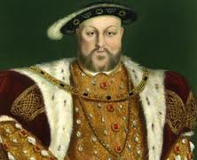
The English Reformation (1517-1640)
Led by King Henry VIII of England
Was caused by emotional and political reasons rather than the need for ACTUAL religious change
In 1509, King Henry VIII married the beautiful Catherine of Aragon. Catherine of Aragon was the aunt of the powerful and influential Holy Roman Emperor Charles V.
After twenty years of marriage, Catherine failed to produce a male heir to the throne. She had only had one surviving daughter: Mary Tudor.
Henry VIII, seeing this, assumed that because Catherine was the ex-wife of Henry’s older brother, them having sexual relations was considered incest. He then assumed that because of this terrible sin, he was not able to produce a male heir
Meanwhile Henry had fallen in love with the beautiful Anne Boleyn. He primarily wanted a divorce so he could be with her.
Realizing that the stars were aligned for Henry VIII and he had a reason for divorce, Henry applied for annulment of his marriage from the Pope.
Henry assumed that he would easily get a divorce because of the pamphlet he had written in 1521 titled Defence of the Seven Sacraments, against Luther. This writing gave him the name of “Defender of the Catholic Faith”.

Slide 14
To the surprise of everyone in England, Henry was not awarded annulment. This was because Catherine nephew was Charles V, the Holy Roman Emperor. Because Charles was the Holy Roman Emperor he had control of Pope Clement VII. Charles refused to let his aunt go through that kid of embarrassment and therefore the pope could not ratify the divorce.
Henry then took matters into his own hands. During the years of 1529 through 1533, Henry used parliament to dissolve all ties with the Church in Rome.
Parliament cut off all revenue to Rome and no longer recognized the Pope’s supreme authority in religious matters in England.
Henry established his own Protestant Church known as the Anglican Church.
In April of 1533, Henry appointed Thomas Cramer as the Archbishop of Canterbury. Cramer then declared Henry’s marriage to Catherine over. By this time Henry had already secretly married the beloved Anne Boleyn who was already three months pregnant. Anne would give birth to Elizabeth Tudor. It wasn’t until Henry’s third wife, Jane Seymour, that Henry finally had a male heir, who would become Edward VI.

Slide 15

The Anglican Church
In 1534 Parliament passed the Act of Supremacy, which made the king of England the head of the church, not the pope. Henry did not change any other doctrines for his new church other than the authority of the pope.
At first, the people of England were angry about this change of religious leadership, but they soon changed their minds. Henry seized all Catholic Church lands and stopped sending money to the Catholic Church. The revenue that Henry got from this nearly made up twenty-five of the English economy. Henry redistributed all the money to his government and all the nobles that supported him.
The Anglican Church also adopted Luther’s ideals with there being only two sacraments: baptism and communion.
Henry spent the remainder of his years persecuting all other types of Protestants from England
After his death Thomas Cramer introduced the Book of Common Prayer, which is still used today. This book outlined all religious proceeding in England.
There were only a few more attempts to thwart the Anglican Church. These were made by Edward VI who introduced Calvinism to England and Mary Tudor who attempted to restore Catholicism in England. It wasn’t until Elizabeth I used the Elizabethan settlement to create a balance between the Anglican Church and the Catholic Church

Slide 16
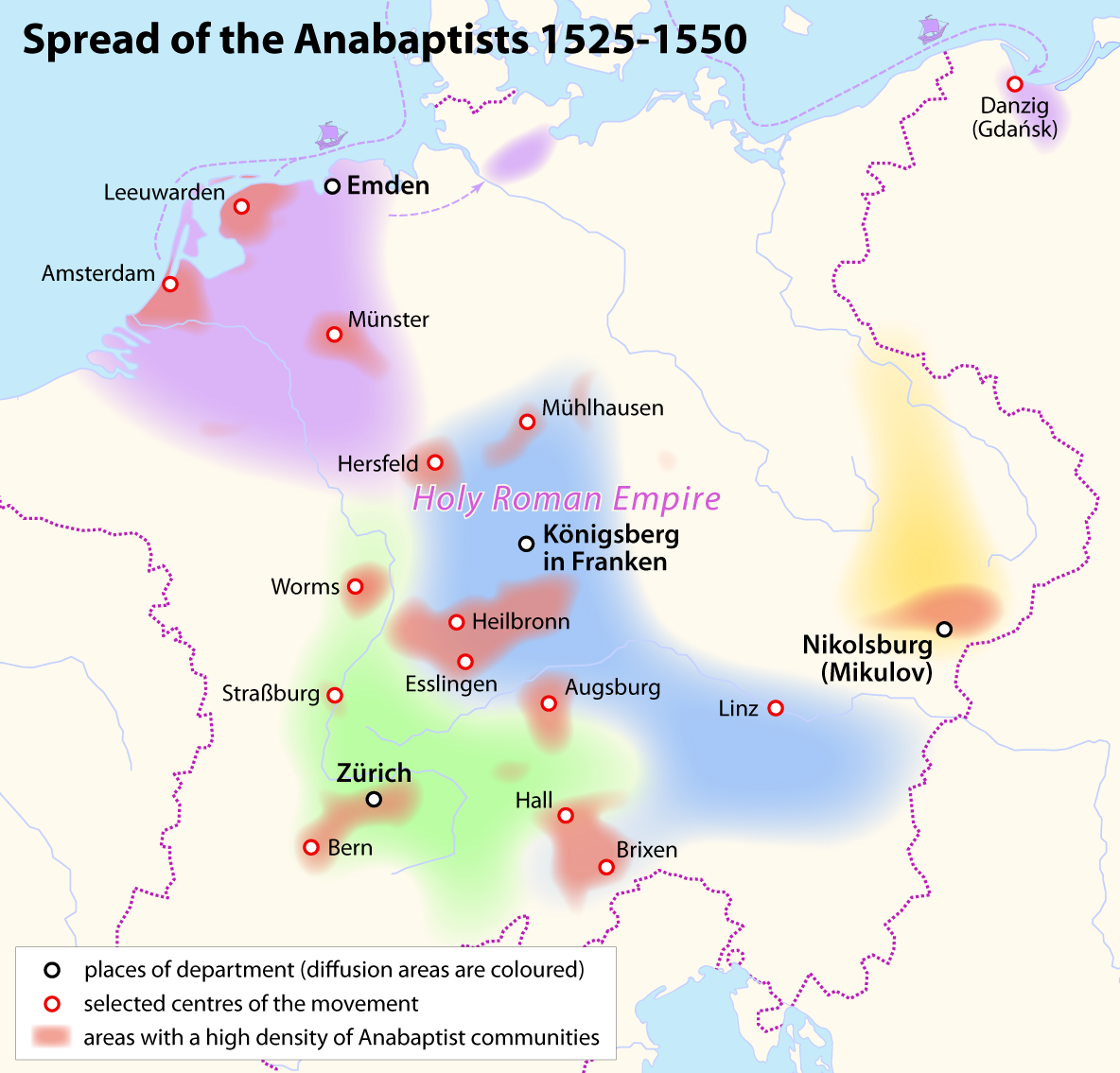
Radical Reformation
Anabaptism
-millenarian: focuses on the imminent ends of the world. One of the most significant Anabaptists that believed this was John of Leiden who took over the City of Munster. These people were generally very violent, but there were also nonviolent forms of Anabaptism
-another form of Anabaptism is the belief that people should be baptized when they are older and when they are adults. They were hated by many
- proposed the idea of the separation between the church and state.

Slide 17

Radical Reformation
Anti-Trinitarians
- denied the validity of the Holy Trinity.
- rejected the idea that the Holy Spirit could be considered one of the three persons in God, saying it had no scriptural validity

Slide 18

Women in the Reformation
The abolition of monasticism for Protestants led to the glorification of the home, which Luther and other reformers stresses as the special domain of the wife where gentler virtues were upheld
Religious schools were creates for boys and GIRLS
Luther believed that women should concern themselves exclusively with the children, kitchen, and the Church. Men should rule the household while the women controlled what was in it
The wives of reformers shared their concerns over religion with their husbands
Educated women wrote treatises on religious issues. These were widely read. Margaret More, Thomas More’s daughter, was considered a scholar.
Catherine Parr, the last wife Henry VIII, wrote a book that evaluated the idea of justification of faith.
Regardless of these simple reforms, there were still only limited opportunities for women..

Slide 19
Work Cited
Butler, Allen. "The Early Writings of Ulrich Zwingli." Yahoo! Contributor Network. Yahoo! Inc, 1 Aug. 2007. Web. 19 Dec. 2012.
Chapter 13, The Spread of Lutheranism. Digital image. Civilization in the West. Pearson Education, Inc., 2010. Web. 19 Dec. 2012.
Church Door Which Martin Luther Put the 95 Theses. Digital image. Galen Fry Singer. N.p., 2005. Web. 19 Dec. 2012.
Eder, James M., and Seth A. Roberts. AP European History. 5th ed. Hauppauge, New York: Baron's Educational Series, 2010. Print.
Gordeeva, Tatyana. Martin Luther. Digital image. German History. N.p., 1999. Web. 18 Dec. 2012.
Gstohl, Mark. "The Radical Reformation." The Radical Reformation. N.p., 2004. Web. 19 Dec. 2012.
Hanawalt, Barbara, Theodore K. Rabb, Isser Woloch, Raymond Grew, and Lisa Tierstan. "Chapter Thirteen: Reformations in Religion." The Western Experience. By Mortimer Chamber. 9th ed. N.p.: McGraw Hill, 2007. 365-93. Print.
Haudenschild, Alain R. Map 2:Spread of Calvinism in Europe Sixteenth Century. Digital image. Rev. Haudenschild, n.d. Web. 19 Dec. 2012. <haudsenchild- com.blogspot.com>.

Slide 20
Work Cited
John Wycliffe. Digital image. Bta. Bible Translation Association, n.d. Web. 19 Dec. 2012.
Johnson, Phil. Antitrinitarian. Digital image. Pyromaniacs: Is Christianity Rational? The Spurgeon Archive, 2006. Web. 19 Dec. 2012. <teampyro.blogspot.com>.
"Martin Luther." 2012. The Biography Channel website. Dec 18 2012, 08:20http://www.biography.com/people/martin-luther-9389283.
Pelton. John Calvin. Digital image. Pastor Pelton. Pastorpelton, 2012. Web. 19 Dec 2012.
Peters, Charlie. Margeret More. Digital image. Catholic Issues. N.p., n.d. Web. 19 Dec. 2012. <canonlaw.info>.
Romano, Michael, Ph.D. AP European History. 2nd ed. Hoboken, NJ: Wiley, 2010. Print.
Smitha, Frank E. "John Wycliffe and Jan Hus." John Wycliffe and Jan Hus. N.p., 2011. Web. 19 Dec. 2012.
Sohn, Emily. King Henry VIII. Digital image. Discovery News. Discovery Communications, 2011. Web. 19 Dec. 2012. <news.discovery.com>.
Spread of the Anabaptist 1525-1550. Digital image. Wikipedia: The Free Encyclopedia. Wikipedia, n.d. Web. 19 Dec. 2012.
St. Johns Anglican Church. Digital image. Ancestry.com. Ancestry.com, 2001. Web. 19 Dec. 2012. <rootsweb.ancestry.com>.
Ulrich Zwingli. Digital image. Reformed Anglicanism. Blogger, n.d. Web. 19 Dec. 2012. <reformationanglicinism.blogspot.com>.
Young, Jeff. John Hus. Portrait of John Hus. Digital image. La Vista Christ Church. La Vista Church of Christ, Dec. 2005. Web. 19 Dec. 2012.

